Slide 1
Engineering Department

Slide 2
Topics of discussion
Pavement
Network and structure
Pavement treatments available
4-5 year plan
Highway Safety Improvement Programs
Cycle 7, 8, 9, & 11
Traffic signal installations
Indian Canyon x Rosa Parks
San Rafael x Ave Caballeros
Traffic Calming Program
Program status

Slide 3
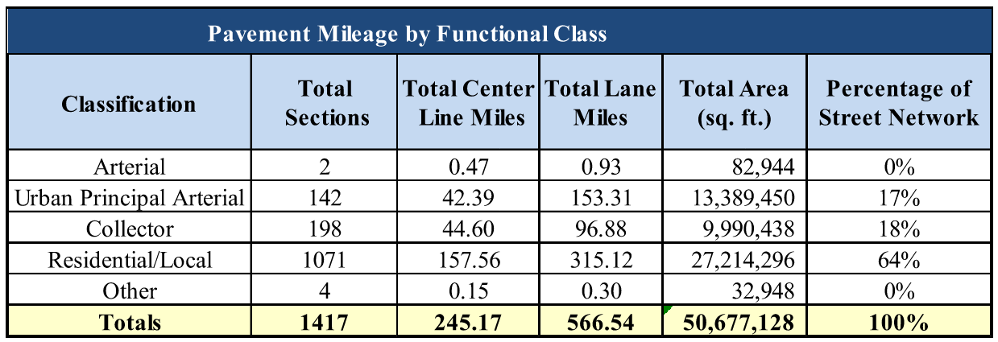
City of Palm Springs Road Network Information
Arterials are major roads that are expected to carry large volumes of traffic.
Collectors are roads that collect traffic from local roads and distribute it to arterials.
Local roads usually have the lowest speed limit and carry low volumes of traffic.

Slide 4
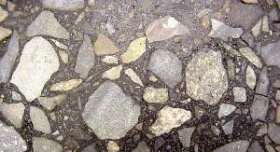
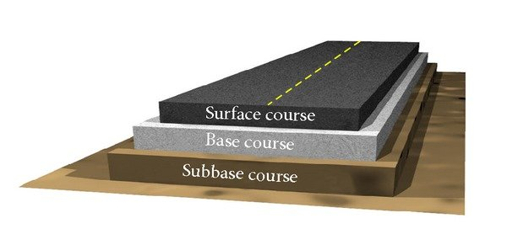
What streets are made of?
Streets are built in layers:
Base course & Subbase Course : usually made of an engineered recipe (mix) of different sized crushed rocks. This is the main load-bearing layer that spreads the weight evenly over the subgrade
Surface course: usually made of asphalt (black) or concrete (gray). Takes on the wear and tear of vehicles. It’s the part exposed to weather. This is the part we see.
Subgrade: the native materials (soil, rock, sand) under a road. It is usually compacted before a road is built on it.

Slide 5
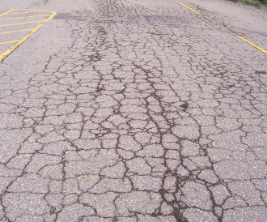
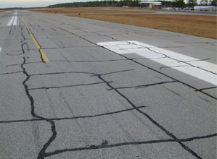
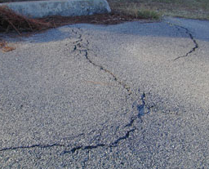
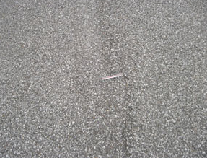
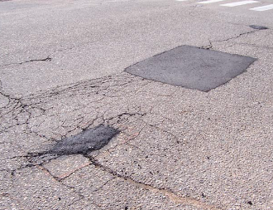
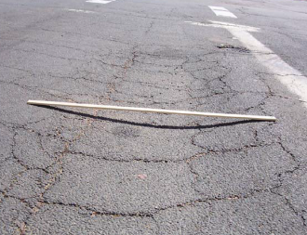
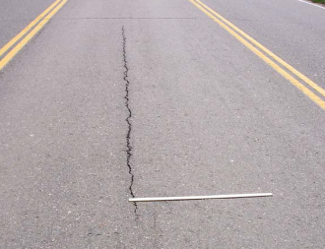
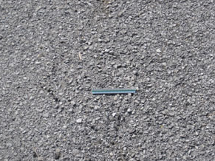
Rating the Pavement
The following information is collected in the field and entered into the pavement management program
Distress Type: 8 Common Distresses used in PMPs
Distress Severity: Low/Medium/High
Distress Quantity: Measurement
The City hires an outside engineering firm who collects this data for each street
Alligator Cracking
Block Cracking
Distortions
Weathering
Patching and Utility Cuts
Rutting and Depressions
Longitudinal and Transverse Cracking
Raveling

Slide 6
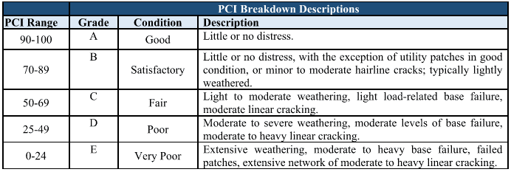
Pavement Condition Index (PCI)
Pavement Condition Index (PCI) is a numerical index between 0 and 100 which is used to indicate the general condition of a pavement
The PCI score helps compare the various streets on an apples to apples basis

Slide 7
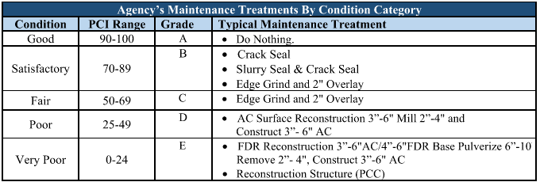
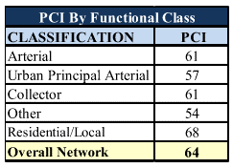
Treatments & PCI by Function

Slide 8
Highway Safety Improvement Programs
Cycle | Locations | Improvements | Status
7 | 17 | Updating with latest traffic safety equipment, including advance dilemma zone detections, convert some locations to protected left turns, and upgrading ramps to ADA standards | In Construction, near completion
8 | 14 | Updating with latest traffic safety equipment, including advance dilemma zone detections, convert some locations to protected left turns, and upgrading ramps to ADA standards | Flashing Beacon Installed, Pending Construction all other areas.
9 | 9 | Upgrade with the latest in traffic safety equip., including installation of advanced dilemma zone detection, upgrading existing traffic signals with full left turn left-turn protected phasing , new video vehicle detection technology, upgraded battery back-up emergency power systems, upgraded curb ramps and related improvements | In Design, Pending Construction in 6-9 months.
10 | 0 | Did not receive grant | Was not awarded, no project
11 | 9 | Upgrade with latest in traffic safety equipment, Install LED ped countdown heads, lighting, add lead pedestrian interval (LPI). | Design pending

Slide 9
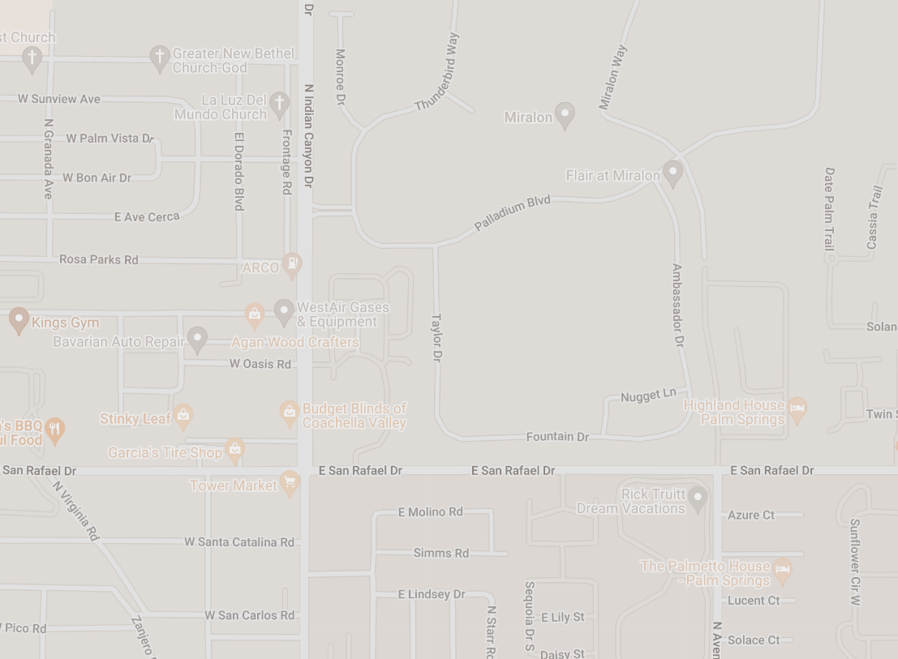
Traffic Signal Installation
CP 20-19
Indian Canyon x Rosa Parks
July 2023
CP 20-33
San Rafael x Ave Caballeros
July 2023

Slide 10
Traffic Calming Program
Data collection time period: October 1st – March 31st
Submitted to City Council for approval in May. Note:
Letters of approval for locations must be signed.
Must have 2/3 in favor at completion of survey/voting.
Workgroup must inform community throughout the process.
Typical time line is 14-months, from CARF submittal to City Council Approval. Various factors contribute to this timeline.
As of 03/2023 the Traffic Calming Program is put on hold for all projects not already approved by City Council. Engineering is looking to increase staff to resume the Program.

